Slide 1
“RAIN SENSING AUTOMATIC CAR WIPER”
BALLARI INSTITUTE OF TECHNOLOGY AND MANAGEMENT
DEPARTMENT OF ELECTRONICS AND COMMUNICATION ENGINEERING
MINI PROJECT
I B Mallikarjuna 3BR33EC057
Indhu Talikoti 3BR22EC060
Manoj B 3BR22EC087
Mehaboob Basha 3BR22EC092
Guide: Dr .Fareduddin
Co-Ordinator: Dr . Naseeruddin

Slide 2
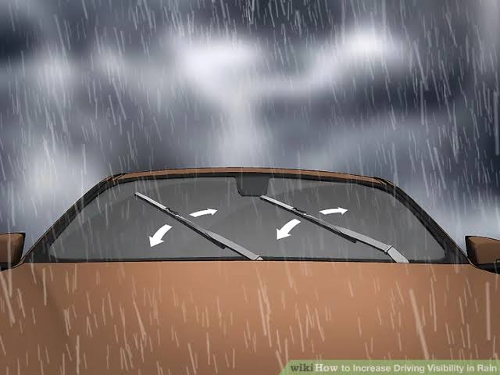
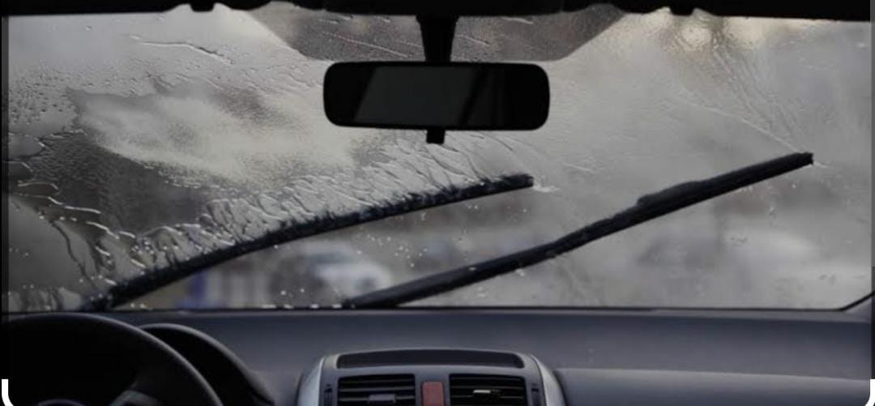
PROBLEM STATEMENT
Manual adjustment of car wipers can distract the driver, increasing the risk of accidents , particularly in heavy or sudden rainfall.
Drivers may not respond promptly to sudden rain intensity changes, leading to decreased visibility and delayed reaction times.
Conventional wipers do not adjust automatically to varying rain conditions, resulting in inconsistent wiping, which can impact visibility and road safety.
Manual wiper operation places an additional cognitive load on the driver, reducing overall driving comfort and convenience.
Lack of an automated system that accurately adjusts wiper speed based on real-time rainfall intensity reduces driving efficiency and safety

Slide 3
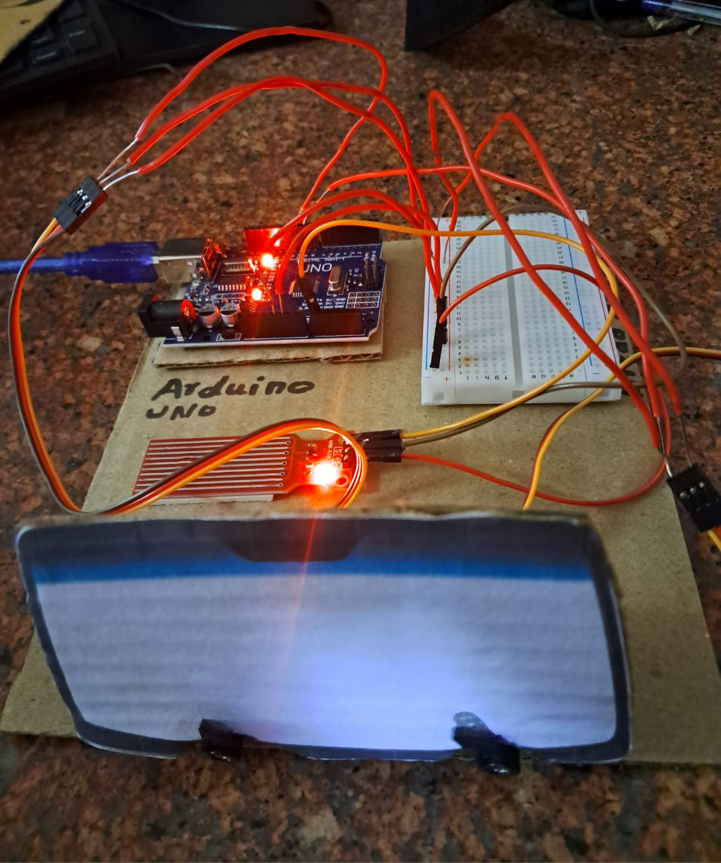
SOLUTION
Develop a rain-sensing automatic car wiper system that detects rainfall and activates wipers without driver intervention.
Implement adaptive wiper speed control based on rain intensity, ensuring continuous optimal visibility.
Design a reliable rain sensor interface with a microcontroller to process rain data and control wiper speed dynamically.
Automate wiper shut-off when rainfall stops, enhancing convenience, energy efficiency, and reducing wear on the wiper blades.
Enhance overall user experience by providing a seamless and hands-free wiper system that automatically adjusts to changing weather conditions

Slide 4
COMPONENTS:-
Software and Hardware requirements:
Arduino board
Servo Motor
Rain drop sensor Module
Bread board
Connecting wires
Arduino IDE software

Slide 5
OBJECTIVES
1.Enhance Driving Safety: Improve driver visibility during rain by automatically adjusting wiper
speed, minimizing distractions and reaction time delays.
2. Automate Wiper Control: Develop a system that detects rainfall intensity and activates the wipers
without manual intervention.
3. Increase Driver Convenience: Eliminate the need for manual adjustments to wiper settings,
allowing drivers to focus more on the road.
4. Energy Efficiency: Design a system that operates the wipers only when necessary, conserving
battery power and reducing wear on the wiper motor.
5. Test and Validate: Ensure the system performs accurately across different rainfall conditions,
temperatures, and lighting environments.

Slide 6
METHODOLOGY :
RAIN SENSOR:
A rain sensor is a device used to detect the presence and intensity of rain or moisture.
In vehicles, it is used to automatically control the windshield wipers based on the rain conditions.
ARDUINO UNO:
The Arduino reads the analog value from the rain sensor using the analog Read A0 function.
Analog Read():Read the input value(0-650 )from the sensor.
The Arduino uses this data to determine how intense the rain is and then adjusts the wiper speed accordingly.
SERVO MOTOR:
servo motors that can rotate to specific position In this system , two servos are used to control the windshield wipers movement.
The servos can move the wiper in a back and –forth motion to clear the windshield.
RAIN SENSOR
ARDUINO
UNO
SERVO MOTOR

Slide 7
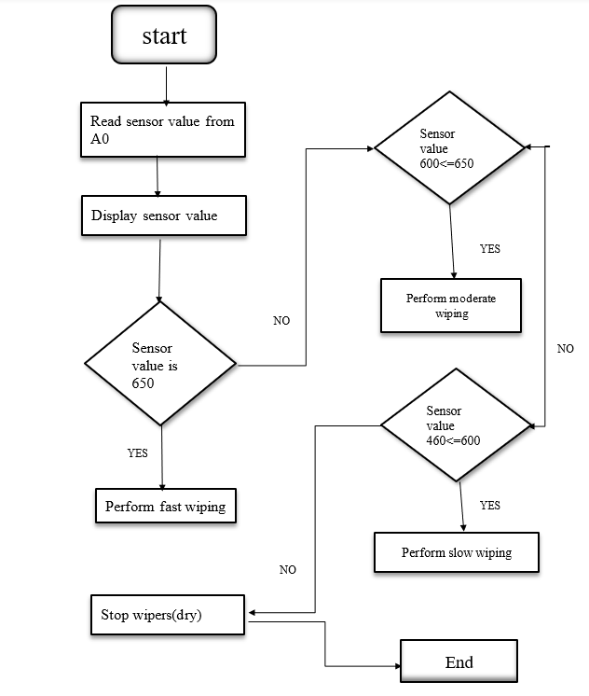
Flowchart:-

Slide 8
OUTCOMES:-
The Rain Sensing Automatic Car Wiper system aims to make driving safer and
more convenient by automatically turning on the wipers and adjusting their speed
based on the rain level. This means drivers won’t need to worry about manually
adjusting the wipers, helping them stay focused on the road. The system is also
designed to save battery power by only using the wipers when needed, which can
help the wiper motor last longer. The final goal is to create a reliable and affordable
system that works well in different rainy conditions and could be easily added to
many types of cars

Slide 9
CONCLUSION
The rain-sensing automatic car wiper is a significant technological innovation that enhances both safety and convenience for drivers. By utilizing sensors to detect rain intensity and automatically adjusting the wiper speed, this system eliminates the need for manual operation, allowing drivers to focus on the road. Its benefits include improved visibility during adverse weather conditions, reduced driver distraction, and optimized performance by adapting to varying rain levels. As automotive technology continues to advance, integrating such intelligent systems further enhances the driving experience while promoting safer road environments.

Slide 10
THANK YOU

